Slide 1
SQL INJECTION ATTACK
Sai Deepak Reddy Emani
(@sai_deepakreddy)
:17BCS11
Under the guidance of
Dr. Uma Seshadri

Slide 2
SQL Injection?
SQL Injection allows a user specified query to execute in the database
Many web applications take user input from a form
Often this user input is used literally in the construction of a SQL query submitted to a database. For example:
SELECT productdata FROM table WHERE productname = ‘user input product name’;

Slide 3
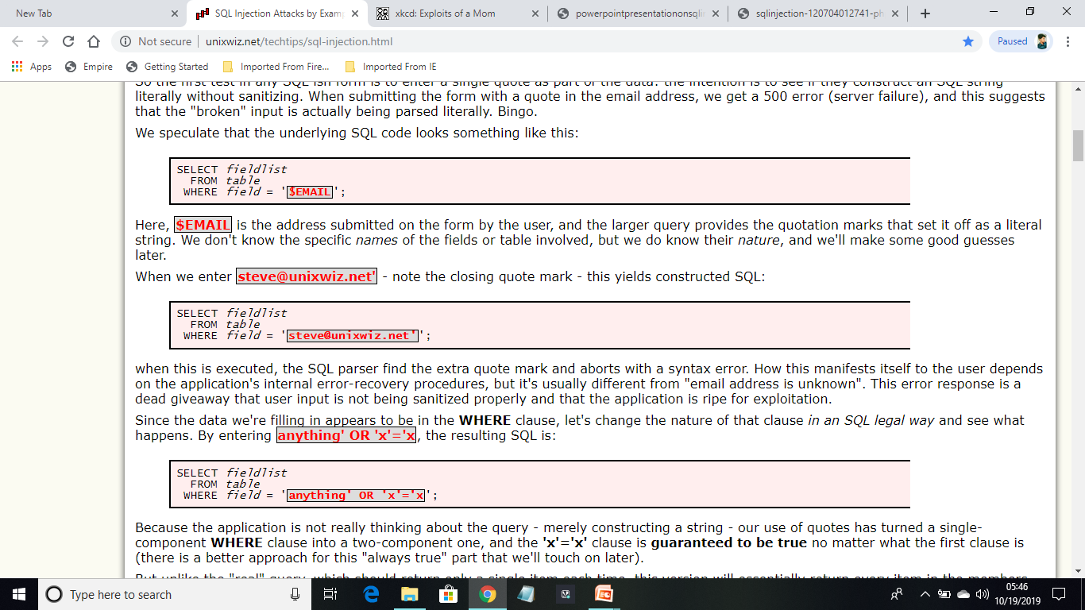
SQL Injection Attack
The login page had a traditional username-and-password form, but also an email-me-my-password link;
Let’s suppose we enter steve@unixwiz.net’ this yields constructed SQL
Returns with syntax error, there the problem comes as user input is not being sanitized properly and one can exploit the application.

Slide 4
Since the data we're filling in appears to be in the WHERE clause, let's change the nature of that clause in an SQL legal way and see what happens. By entering anything' OR 'x'='x, the resulting SQL is:
As the 'x'='x' clause is guaranteed to be true no matter what the first clause is, hence returns a message
The credentials has been mailed to random.person@site.com
Though we haven't got what we expected, but we know that we're able to manipulate the query to our own ends

Slide 5
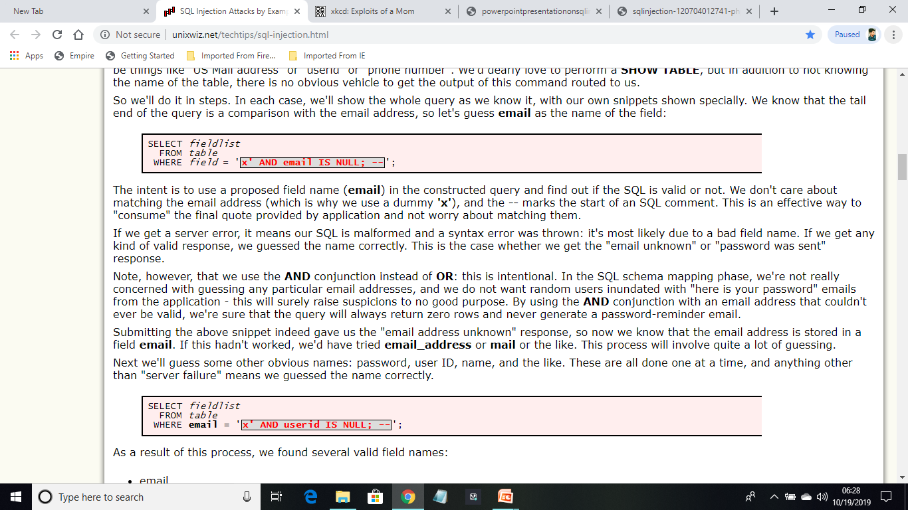
Schema Field mapping
In order to retrieve the database, one has to know the table name of that particular database.
Two possibilities, either syntax error(bad SQL construction) or email not found/password sent.
If syntax error is the case keep guessing, if not try out other table names.

Slide 6
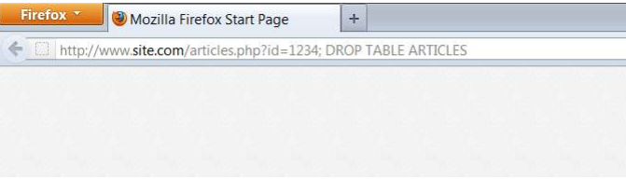
Finding table name
http://www.site.com/articles.php ?id=1234 UNION SELECTgroup_concat(table_name),2,3,4,5,6,7,8,9,10,11,12, 13,14,15,16,17 ,18,19,20,21,22,23,24 from information_schema.tables where table_schema=database()—
With the above command one can get table name.

Slide 7
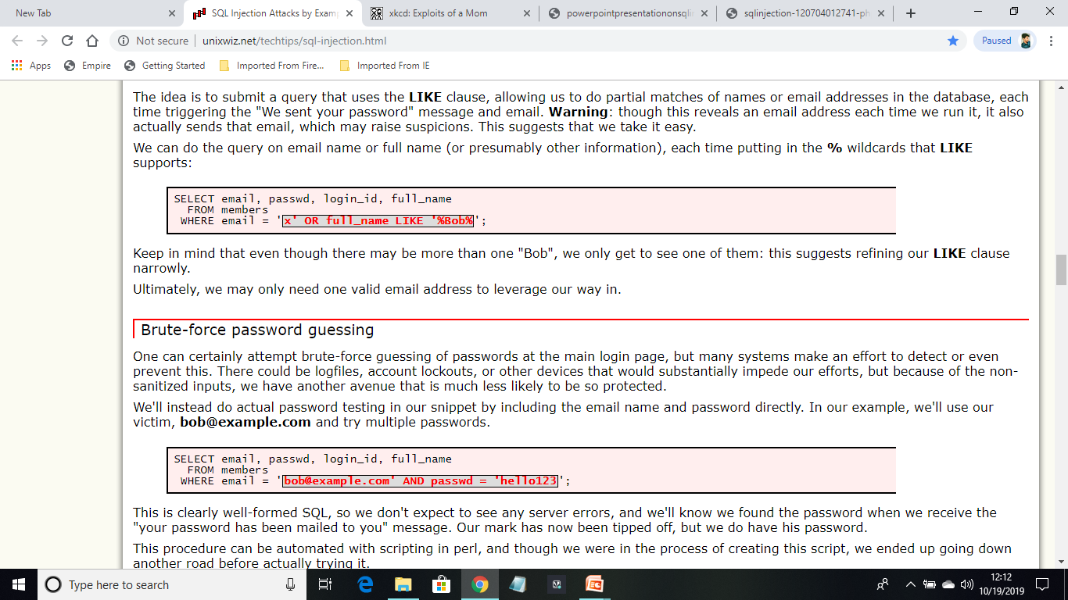
Finding some user
The idea is to submit a query that uses the LIKE clause, allowing us to do partial matches of names or email addresses in the database
Warning: though this reveals an email address each time we run it, it also actually sends that email, which may raise suspicions.

Slide 8
Brute force Password guessing
A guessing work performed where there is less protection.
We'll instead do actual password testing in our snippet by including the email name and password directly. In our example, we'll use our victim, bob@example.com and try multiple passwords.
This is clearly well-formed SQL, so we don't expect to see any server errors, and we'll know we found the password when we receive the "your password has been mailed to you" message.

Slide 9
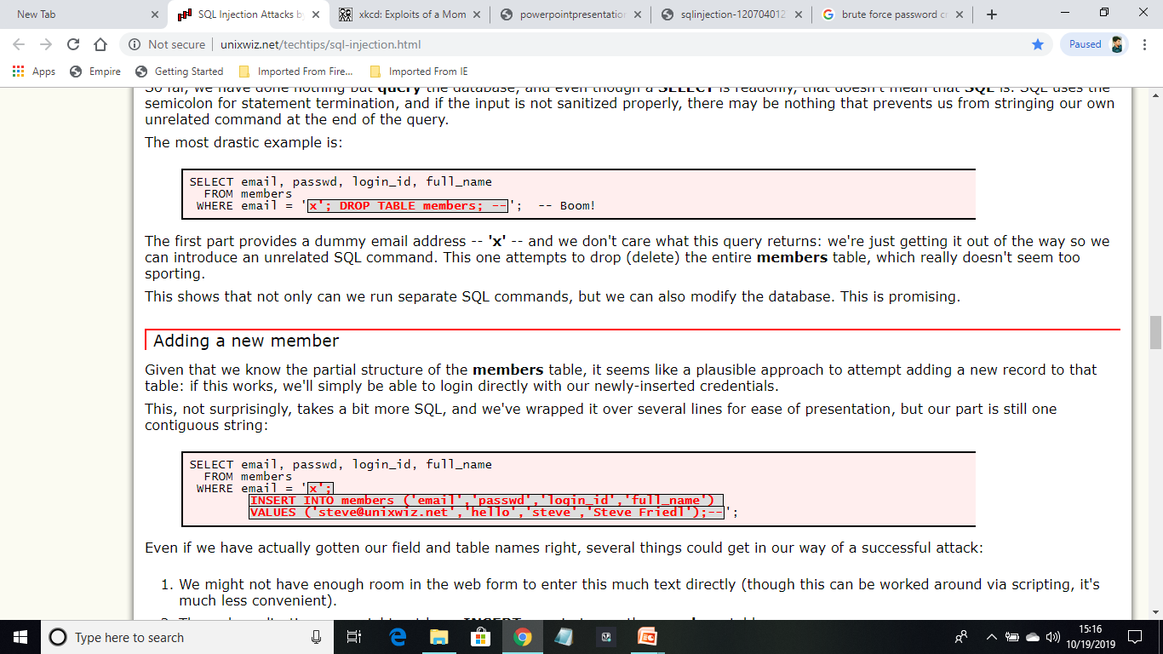
Deleting the data
SQL uses the semicolon for statement termination, and if the input is not sanitized properly, there may be nothing that prevents us from stringing our own unrelated command at the end of the query.
The first part provides a dummy email address -- 'x' -- and we don't care what this query returns: we're just getting it out of the way so we can introduce an unrelated SQL command. This one attempts to drop (delete) the entire members table.

Slide 10
Adding data(new user)
Given that we know the partial structure of the members table, it seems like a plausible approach to attempt adding a new record to that table:
A possible approach here is attempting to guess the other fields, but this promises to be a long and laborious process: though we may be able to guess other "obvious" fields, it's very hard to imagine the bigger-picture organization of this application.

Slide 11
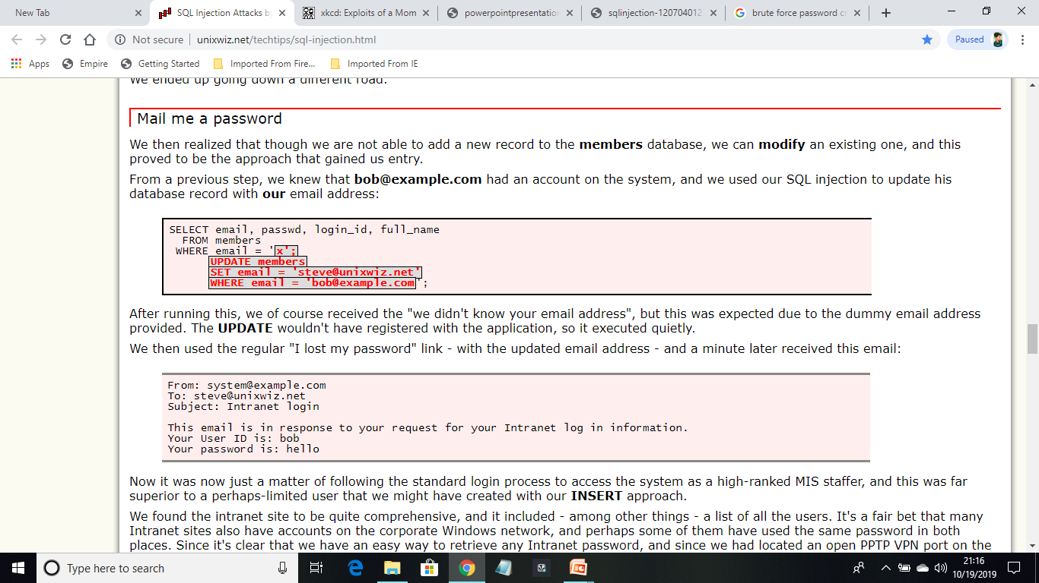
Mail me password
We then realized that though we are not able to add a new record to the members database, we can modify an existing one, and this proved to be the approach that gained us entry.
From a previous step, we knew that bob@example.com had an account on the system, and we used our SQL injection to update his database record with our email address:

Slide 12
Cont…
After running this, we of course received the "we didn't know your email address", but this was expected due to the dummy email address provided. The UPDATE wouldn't have registered with the application, so it executed quietly.
We then used the regular "I lost my password" link - with the updated email address - and a minute later received this email:

Slide 13
Mitigations, SQL Preventions

Slide 14
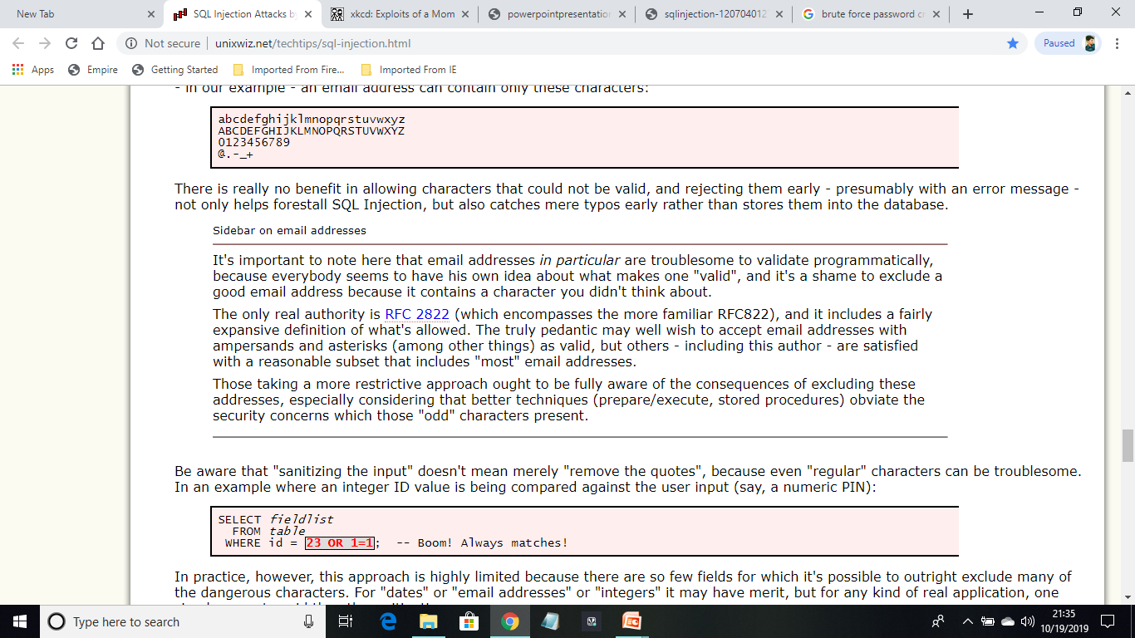
Sanitize the input
Strip out the ‘bad stuff’- quotes, semicolons or escapes
In a precise way remove everything, but known good data.
Reject the characters that could not be valid, presumably with an error message- even eliminate typos

Slide 15
Cont…
Sanitizing the input doesn’t mean merely ‘removing the quotes’, because even "regular" characters can be troublesome.
In an example where an integer ID value is being compared against the user input (say, a numeric PIN):

Slide 16
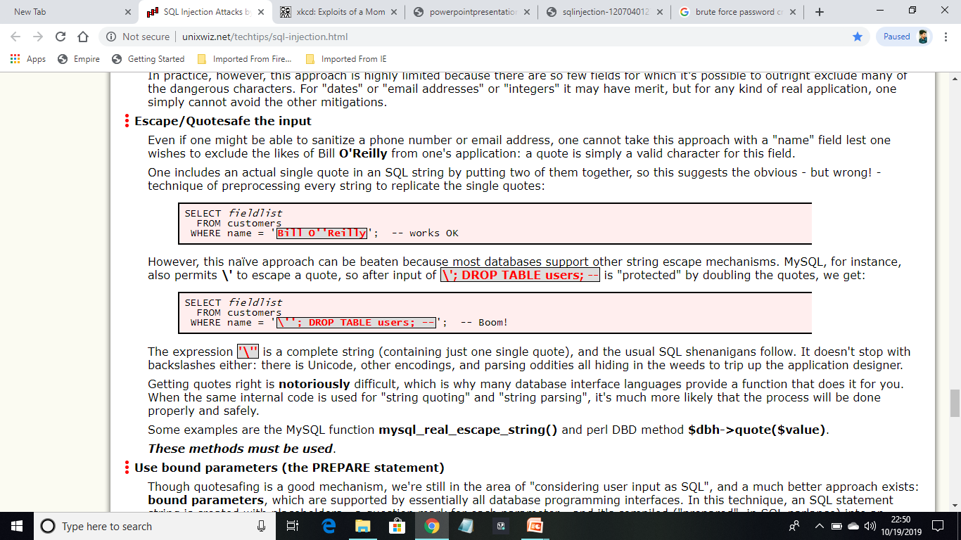
Escape/Quotesafe the input
When ever we come with the name field like Billy O’Reilly, one exclude the single quote by putting double quote!
MySQL, for instance, also permits \' to escape a quote, so after input of \'; DROP TABLE users; -- is "protected" by doubling the quotes, we get:
MySQL function mysql_real_escape_string() and perl DBD method $dbh->quote($value).

Slide 17
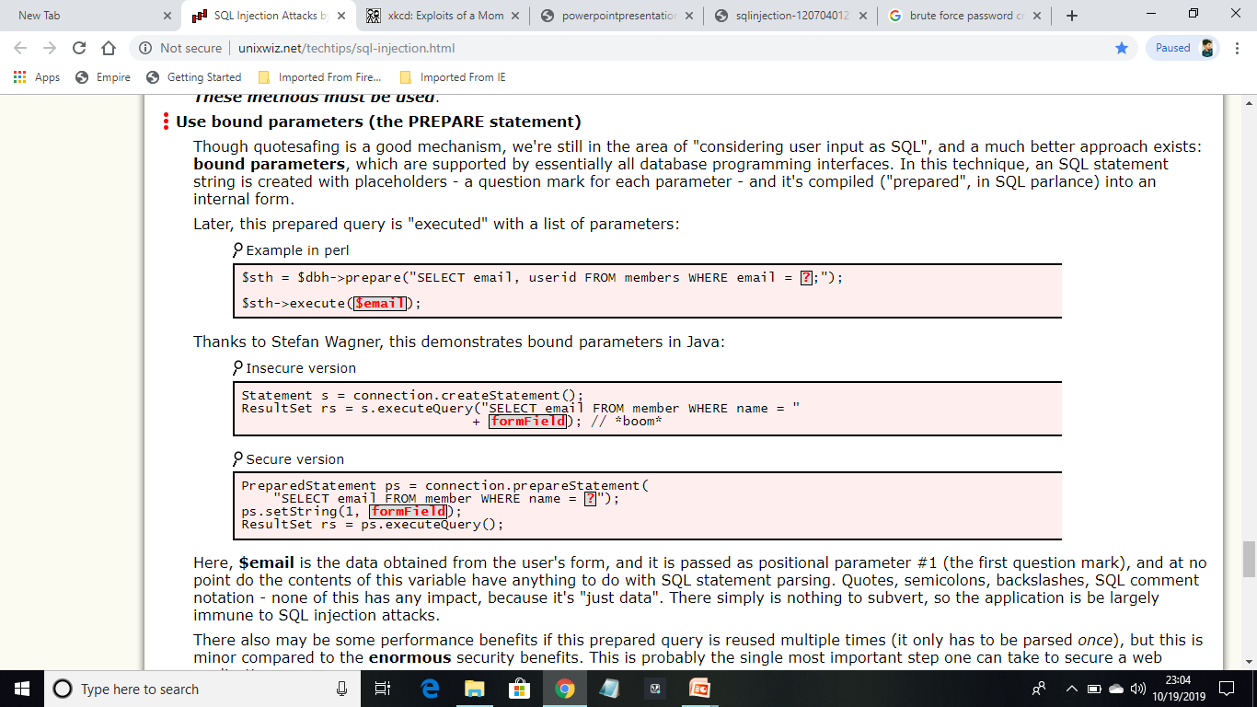
Use bound parameters (the PREPARE statement)
an SQL statement string is created with placeholders - a question mark for each parameter - and it's compiled ("prepared", in SQL parlance) into an internal form.

Slide 18
Limit database permissions and segregate users
If you’re only reading the database, connect to database as a user that only has read permissions
Never connect as a database administrator in your web application
Once the web application determined that a set of valid credentials had been passed via the login form, it would then switch that session to a database connection with more rights.

Slide 19
Configure error reporting
Default error reporting often gives away information that is valuable for attackers (table name, field name, etc.)
Configure so that this information is never exposed to a user
ISOLATE the Web server – Not giving complete access to administrator.

Slide 20
Types of SQLIA
Tautology- Which is always true.(1=1)
Logically incorrect queries.
Union Query-- The attacker provides the incorrect data with the few correct fields, the SQL query is sent with the ‘Union’ of both correct and incorrect fields
SELECT acc_inf FROM clients WHERE login=’’ UNION SELECT card_No FROM Credit_Cards WHERE acct_No=12450 -- AND pass=’’ AND pin=

Slide 21
Types of SQLIA
Piggy-backed queries is a type of attack that compromises a database using a query delimiter, such as ";", to inject additional query statements to the original query. In this method the first query is original whereas the subsequent queries are injected.
SELECT acc_No FROM client WHERE login = ‘ritu’ AND pass = ‘’; DROP TABLE client -- 'AND pin = 321

Slide 22
Types of SQLIA
Stored Procedures --attacker focuses on the stored procedures which are present in the database system. Stored procedures run directly by the database engine. it is a piece of code which is exploitable.
SELECT acc FROM client WHERE Login= '1231' AND Pass='9999 '; SHUTDOWN;--;
It works like piggyback attack. Firstly the existing query is processed subsequently followed by the other query which gets implemented and leads to shutting down of the database.

Slide 23
Try this
http://sqlzoo.net/hack/

Slide 24
References
http://www.unixwiz.net/techtips/sql-injection.html
classes.soe.ucsc.edu/.../SQL%20Injection%20Attacks.ppt
homes.cs.washington.edu/~suciu/current-trends.ppt
www.cse.iitb.ac.in/dbms/Data/.../DBSecurity-Overview.ppt

Slide 25
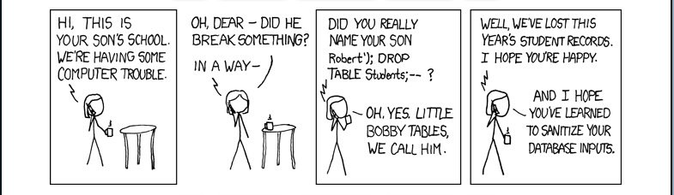
THANK YOU
Source: https://xkcd.com/327/
Questions?

